Slide 1
Determining the optimum location to set up a gym in Manhattan
IBM Capstone Project

Slide 2
The problem I have chosen to analyse involves the decision regarding where to open a gym in Manhattan, New York City , USA. There are several factors which will play a role in determining this optimal location. The gym needs to be centrally located and needs to be easily accessible from all parts of the city.
The gym should also have complementary venues near it. For example, the presence of a spa nearby will encourage customers to purchase gym membership of said gym. The gym should also not exist in a place where several gyms already exist which would generate unnecessary competition. Clusters will be generated to assess each neighbourhood.
I will attempt to generate a list of neighbourhoods most suitable which will result in maximum revenue for the stakeholder wishing to set up the gym.
Business Problem

Slide 3
DATA
Based on the factors I discussed above, the following data will be required:
· The distance of each neighbourhood from the centre of the city.
· The venues nearby which are complementary to the gym.
· The number of gyms that exist in each neighbourhood.
The neighbourhoods have been identified from the source: https://cocl.us/new_york_dataset. All the features will be extracted from this data source. The other data will be extracted using the Foursquare API. The location of each neighbourhood will be obtained from the GeoPy GeoCoder package in Python.

Slide 4
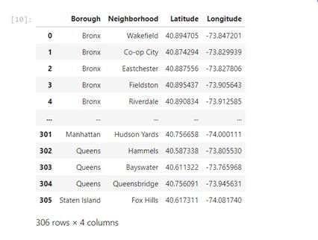
Data frame

Slide 5
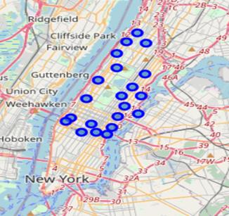
Map of Manhattan containing the relevant neighborhoods

Slide 6
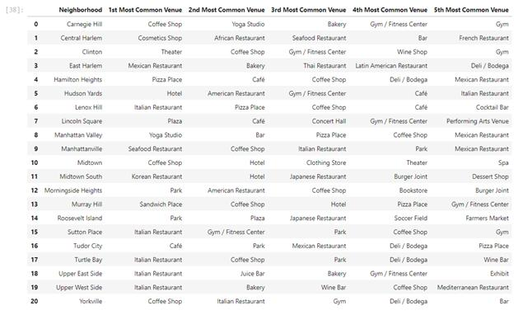
Analysis using FOURSQUARE API

Slide 7
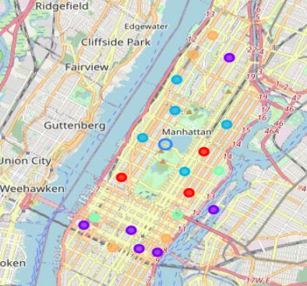
KNN CLUSTERS ON THE MAP OF MANHATTAN

Slide 8
INFORMATION ABOUT THE CLUSTERS
Cluster 1- It represents the neighbourhoods that are at a greater distance from the centre of Manhattan. Each neighbourhood as at least 1 gym. I would not recommend setting up a gym here as it is far from Central Park. These neighbourhoods are marked in red.
Cluster 2 - These are neighbourhoods with plenty of gyms already. There will be fierce competition here and that may impact revenue. These points are marked in purple.
Cluster 3 - These are the points closest to Central Park and are greatly untapped. These neighbourhoods offer great potential. I would recommend these neighbourhoods. However, one must keep in mind that these neighbourhoods are expensive and there will be significant overhead costs to setting up a gym here. These points are marked in light blue.

Slide 9
Cluster 4 - These are points that are slightly further away from the centre. However, no gym exists in the neighbourhood of these vicinities so it may result in high revenue. The cost of setting up the gym might also be much lower than cluster 2. They are marked in light green.
Cluster 5- This cluster shows points that are somewhat between the outskirts and centre of Manhattan. There exist gyms already which may offer some competition. However, that number is far lesser than that of cluster 1. They can also be promising as prices will be lower. These are shown in orange.

Slide 10
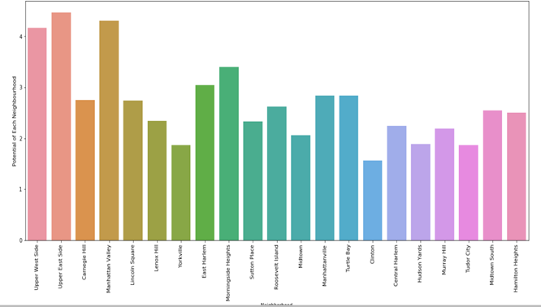
BAR GRAPH OF POTENTIAL VS NEIGHBOURHOOD

Slide 11
CONCLUSION
The purpose of this project was to identify a suitable location for stakeholders looking to set up a gym. Through the application of clustering and Foursquare API, I have identified the best neighbourhoods for this project. They are
· Manhattan Valley
· Upper East Side
· Manhattanville
· Turtle Bay
Manhattan Valley would require higher capital but would generate the maximum revenue. It is the closest to the centre and has complementary businesses. Upper East Side is a good prospect as well but will be even more expensive. Manhattanville and Turtle Bay are ideal prospects for stakeholders who would not wish to play the excessive charges of location. The competition in this region is higher as most gym owners would prefer this region.

